Slide 1
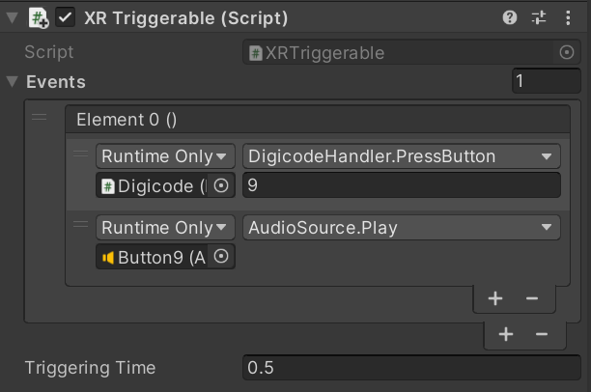
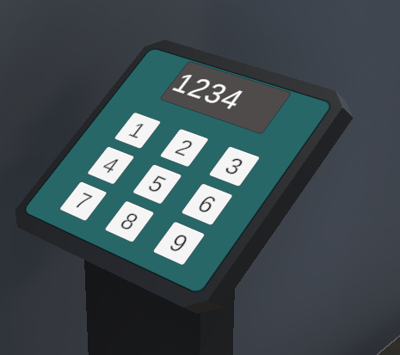
Attach Predefined Mono Script XRTriggerable to a Button GameObject

